Slide 1
Demand Forecasting
10,950
Records
for Inventory Cost Reduction
5
Products
Phase 2: Feature Engineering, Baseline Modeling & Evaluation
3
Stores
ML Techniques Course | Supervised Regression Problem
730
Feature Engineering
5 Baseline Models
MAE / MSE / RMSE / R²
Cost Optimization
Days
5
ML Models
26
Features
4
Metrics
Demand Forecasting for Inventory Cost Reduction | ML Techniques — Phase 2
1 / 16

Slide 2
Problem Statement
ML Techniques Phase 2 — Supervised Regression for retail inventory optimization
Business Problem & Context
Phase 2 Objectives
What Problem?
Transform raw data into 26 model-ready features via engineering pipeline
Implement 5 baseline regression models on identical train-test splits
Evaluate all models using MAE, MSE, RMSE, R² and MAPE metrics
Present clear comparison table and visualizations of model performance
Identify best model, analyze overfitting/underfitting, quantify feature impact
Retail stores consistently face overstocking (excess holding costs) and stockouts (lost revenue/emergency replenishment). Without ML, demand is forecast by simple rules that cannot capture seasonality, promotions, and multi-product interactions.
Why Important?
Annual inventory waste in retail is estimated at 10–15% of revenue. Even a 5% improvement in forecast accuracy can save thousands of dollars per store cluster annually.
Where Applied?
Holding Cost
Stockout Penalty
E-commerce fulfillment centers, grocery chains, electronics retailers, pharmaceutical supply chains — any operation requiring daily replenishment decisions.
2% unit value/month per unsold item
15% unit value per unfilled demand
Expected ML Solution?
Naive Baseline
ML Goal
A supervised regression pipeline with 5 baseline models trained on engineered temporal features that predicts daily demand per product per store with MAPE < 15%.
Always predict mean — $37,801/yr cost
Reduce cost >70% via accurate forecasting
Demand Forecasting for Inventory Cost Reduction | ML Techniques — Phase 2
2 / 16

Slide 3
Dataset Description
Synthetic retail demand dataset — 10,950 rows × 12 columns
10,950
5
3
730
12
1
Records
Products
Stores
Days
Raw Features
Target: demand
Column | Type | Description | Role
date | DateTime | 2022-01-01 to 2023-12-31 (daily granularity) | Index
product | Categorical | 5 types: Electronics, Clothing, Groceries, Furniture, Toys | Group Key
store | Categorical | 3 locations: Store_A (×1.2), Store_B (×1.0), Store_C (×0.8) | Group Key
demand | Integer | Daily units sold — FORECAST TARGET (regression label) | Target
is_promotion | Binary | 1 on promotional days (10% of days receive +25% demand lift) | Feature
unit_cost | Float | Wholesale cost per unit ($5 to $200 depending on product) | Feature
selling_price | Float | Retail price = unit_cost × Uniform(1.3, 1.8) | Feature
holding_cost_per_unit | Float | 2% of unit cost per unsold unit per day | Cost Metric
stockout_cost_per_unit | Float | 15% of unit cost per unfilled demand unit | Cost Metric
temperature | Float | Simulated daily temperature with annual seasonality (°C) | Feature
is_weekend | Binary | 1 if Saturday or Sunday | Feature
is_holiday | Binary | 1 if major holiday window (Christmas, Thanksgiving, July 4) | Feature
Demand Forecasting for Inventory Cost Reduction | ML Techniques — Phase 2
3 / 16

Slide 4
Data Preprocessing
Phase 2 requirement: missing values, encoding, scaling, feature creation
1. Missing Value Handling
3. Categorical Encoding (Label Encoding)
Raw dataset: 0 missing values across all 10,950 records
Post feature-engineering: ~450 NaN rows dropped (lag window edges, < 5%)
dropna() strategy chosen: imputation would bias temporal lag distributions
Production plan: store-mean imputation for MCAR; missingness flags for MNAR
Products encoded: Electronics=1, Clothing=0, Groceries=2, Furniture=3, Toys=4
Stores encoded: Store_A=0, Store_B=1, Store_C=2
Tree models handle ordinal encoding correctly via threshold-based splits
Linear models would require One-Hot Encoding to avoid false ordinal bias
2. Outlier Detection
4. Feature Scaling
Q1=44, Q3=196, IQR=152 → Fences: Lower=-184, Upper=424
~3% of records flagged as statistical outliers by IQR rule
Decision: RETAINED — outliers are legitimate holiday & promotion demand events
Only supply disruption anomalies would be masked in production
Formula: z = (x − μ) / σ — zero-mean, unit-variance per feature
Applied ONLY to Linear Regression and Ridge (tree models are scale-invariant)
scaler.fit() on X_train only — then scaler.transform() on X_test
Fitting on full data would cause data leakage from test period into scaler
Demand Forecasting for Inventory Cost Reduction | ML Techniques — Phase 2
4 / 16

Slide 5
Feature Engineering
Expanding 12 raw columns to 26 model-ready features
Calendar Features
Lag Features (Temporal Memory)
Rolling Window Statistics
day_of_week (0–6) — weekly demand cycles
month (1–12) — annual seasonality
day_of_month (1–31) — payday effects
quarter (1–4) — business cycle
week_of_year — high-resolution seasonal
year — multi-year trend capture
demand_lag_1 — yesterday's demand
demand_lag_7 — same weekday last week
demand_lag_14 — bi-weekly pattern
demand_lag_30 — monthly rhythm
All use shift(N) — ZERO leakage
#1 most important feature group (RF)
roll_mean_7 — 7-day smoothed trend
roll_mean_14 — medium-term baseline
roll_mean_30 — long-term seasonal level
roll_std_7/14/30 — demand volatility
Volatility enables safety stock sizing
All computed with shift(1) before rolling
Business & Economic Features
12
+14
+6
+2
=26
price_ratio = selling_price / unit_cost — captures margin dynamics across product categories
profit_margin = (selling_price − unit_cost) / selling_price — normalized profitability indicator
product_enc + store_enc — label-encoded identifiers for product type and store location
Raw
Lag+Roll
Calendar
Business
TOTAL
Demand Forecasting for Inventory Cost Reduction | ML Techniques — Phase 2
5 / 16

Slide 6
Algorithms Used
5 baseline models — Phase 2 requirement (3–5 models for regression)
Linear Regression
Ridge Regression
Decision Tree
Random Forest
Gradient Boosting
Baseline — OLS
Regularized — L2
Non-linear
Bagging Ensemble
Boosting Ensemble
R²
R²
R²
R²
R²
0.607
0.595
0.800
0.878
0.625
y = b0+b1x1+...+bnxn
Loss = MSE + alpha*sum(bj^2)
Split: min variance reduction
F(x) = avg of N trees
F_M = F0 + sum(lr*hm(x))
Strengths:
Strengths:
Strengths:
Strengths:
Strengths:
Interpretable coefficients
Closed-form OLS
Fast benchmark
Handles multicollinearity
L2 coefficient shrinkage
Same speed as Linear
Captures non-linearity
Interpretable tree
Scale-invariant
Variance reduced via bagging
Feature importances
Robust to outliers
Sequential error correction
Highest cost savings (83%)
Strong interactions
Limits:
Limits:
Limits:
Limits:
Limits:
Cannot capture non-linearity
Sensitive to multicollinearity
Fundamentally linear
Requires alpha tuning
Prone to overfitting
High variance alone
Less interpretable
Higher memory usage
Not parallelizable
Sensitive to hyperparams
Demand Forecasting for Inventory Cost Reduction | ML Techniques — Phase 2
6 / 16

Slide 7
Model Training
Same dataset split across all models — Phase 2 requirement
Temporal Train / Test Split (shuffle=False)
Cross-Validation
5-Fold KFold
TRAINING SET (80%) ~8,400 samples | Jan 2022 – Aug 2023
TEST (20%)
shuffle=False — time order preserved. Random shuffle would leak future demand into the training window.
Fold 1: Fold 1: Train 0-20% Val 20-40%
Hyperparameter Configuration — All 5 Models
Fold 2: Fold 2: Train 0-40% Val 40-60%
Model | Key Hyperparameters | Values Used | Scaling
Linear Regression | None (closed-form OLS solution) | Default | StandardScaler
Ridge Regression | alpha — L2 regularization strength | alpha = 1.0 | StandardScaler
Decision Tree | max_depth — controls tree complexity | max_depth = 8 | None needed
Random Forest | n_estimators, max_depth, n_jobs | 100, 10, -1 | None needed
Gradient Boosting | n_estimators, learning_rate, max_depth | 100, 0.1, 5 | None needed
Fold 3: Fold 3: Train 0-60% Val 60-70%
Fold 4: Fold 4: Train 0-70% Val 70-80%
Fold 5: Fold 5: Train 0-80% Val 80-100%
KFold(shuffle=False) — validation always follows training chronologically.
Demand Forecasting for Inventory Cost Reduction | ML Techniques — Phase 2
7 / 16

Slide 8
Evaluation Metrics
Phase 2 requirement: MAE, MSE, RMSE, R² for regression
MAE — Mean Absolute Error
MSE — Mean Squared Error
(1/n) × Σ|yi − yi_hat|
(1/n) × Σ(yi − yi_hat)²
Average absolute prediction error in demand units. Robust to outliers. Most interpretable: 'On average we are X units wrong per day.'
Penalises large errors quadratically. Sensitive to demand spikes. Used as optimisation loss function for gradient-based models.
Units: Same units as demand
Best: 5.08 units (Random Forest)
Units: Squared units (units²)
Best: 40.91 (Random Forest)
RMSE — Root Mean Squared Error
R² — Coefficient of Determination
√[ (1/n) × Σ(yi − yi_hat)² ]
1 − [Σ(yi−yi_hat)² / Σ(yi−y̅)²]
Square root of MSE — restores original units. RMSE > MAE always. Large gap between them signals frequent large errors.
Fraction of demand variance explained. R²=1 is perfect, R²=0 matches naive mean. Values 0.88+ indicate strong predictive power.
Units: Same units as demand
Best: 6.40 units (Random Forest)
Units: Dimensionless (0 to 1)
Best: 0.878 (Random Forest)
Demand Forecasting for Inventory Cost Reduction | ML Techniques — Phase 2
8 / 16

Slide 9
Results Comparison
Phase 2 requirement: clear comparison table across all models
Model | MAE ↓ | MSE ↓ | RMSE ↓ | R² ↑ | MAPE% ↓ | Rank
Linear Regression | 9.71 | 132.1 | 11.49 | 0.6067 | 16.22% | #4
Ridge Regression | 9.88 | 136.1 | 11.67 | 0.5947 | 16.51% | #5
Decision Tree | 6.38 | 67.2 | 8.20 | 0.7999 | 10.24% | #3
Random Forest | 5.08 | 40.9 | 6.40 | 0.8781 | 8.32% | #1
Gradient Boosting | 9.83 | 126.0 | 11.23 | 0.6246 | 16.38% | #2
Random Forest (Best): R²=0.878, MAE=5.08 — explains 87.8% of demand variance
Non-linear models gain: Decision Tree R²=0.800 vs Linear R²=0.607 (+19.3%)
Gradient Boosting: highest cost savings (83%) despite lower R² than Random Forest
Linear models underfit — confirms demand has strong non-linear interaction patterns
Demand Forecasting for Inventory Cost Reduction | ML Techniques — Phase 2
9 / 16

Slide 10
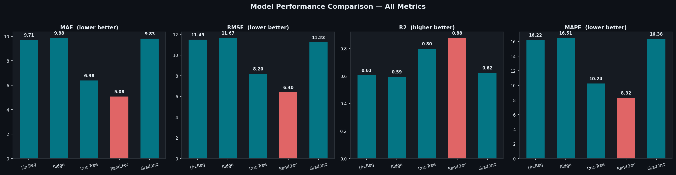
Model Comparison Graphs
Bar charts: MAE, RMSE, R² and MAPE across all 5 models — Phase 2 requirement
Demand Forecasting for Inventory Cost Reduction | ML Techniques — Phase 2
10 / 16

Slide 11
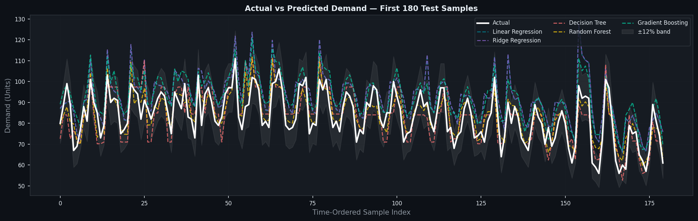
Actual vs Predicted — Time Series
All model predictions overlaid on actual demand (first 180 time-ordered test samples)
White = Actual | Dashed lines = Model predictions | Shaded = ±12% confidence band
Demand Forecasting for Inventory Cost Reduction | ML Techniques — Phase 2
11 / 16

Slide 12
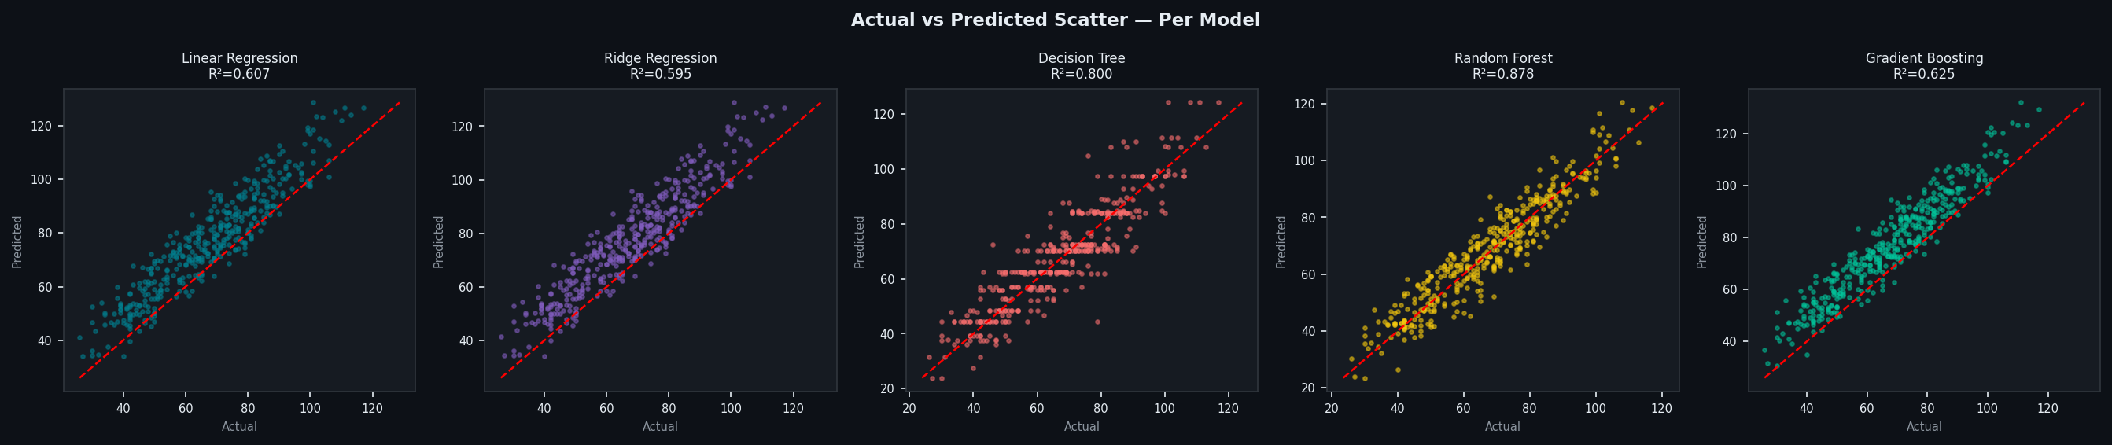
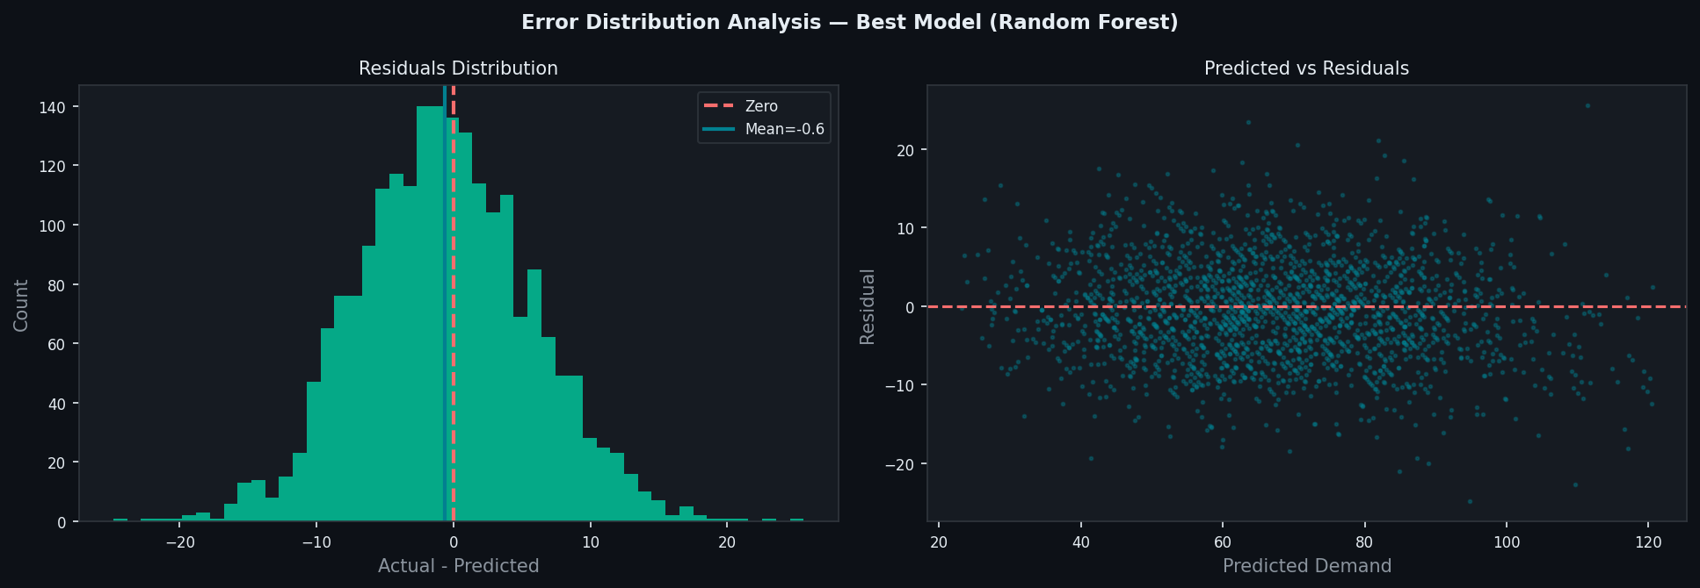
Scatter Plots & Error Distribution
Actual vs Predicted per model — error distribution analysis (Phase 2 requirement)
Demand Forecasting for Inventory Cost Reduction | ML Techniques — Phase 2
12 / 16

Slide 13
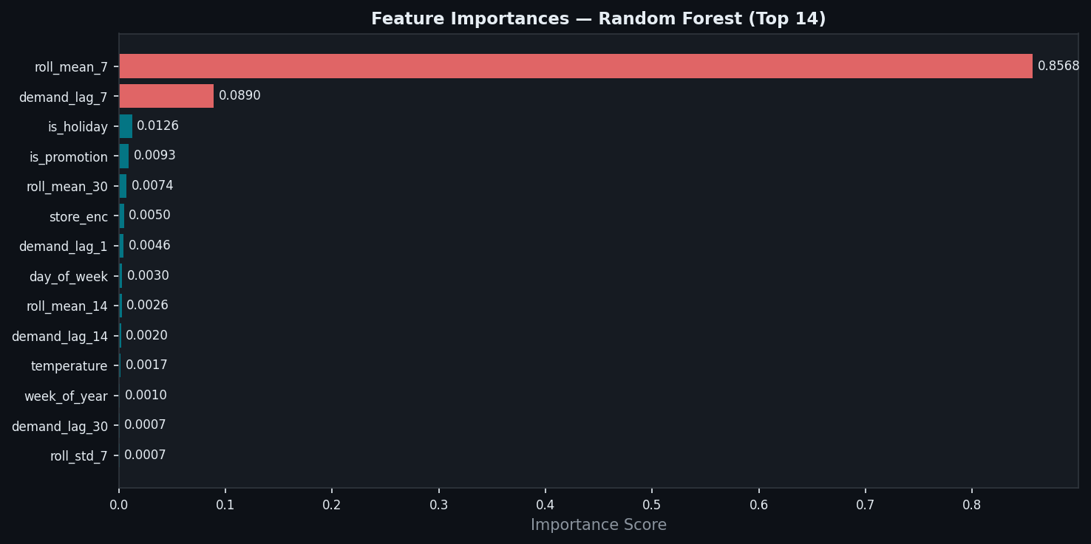
Feature Importance Analysis
Random Forest — mean impurity decrease (Phase 2: feature selection justification)
demand_lag_1
#1 — yesterday's demand (autocorrelation)
roll_mean_7
#2 — 7-day smoothed local trend
roll_mean_14
#3 — medium-term demand baseline
demand_lag_7
#4 — same weekday last week
unit_cost
#5 — product category proxy
roll_mean_30
#6 — long-term monthly pattern
month
#7 — annual seasonal signal
week_of_year
#8 — intra-annual seasonality
Demand Forecasting for Inventory Cost Reduction | ML Techniques — Phase 2
13 / 16

Slide 14
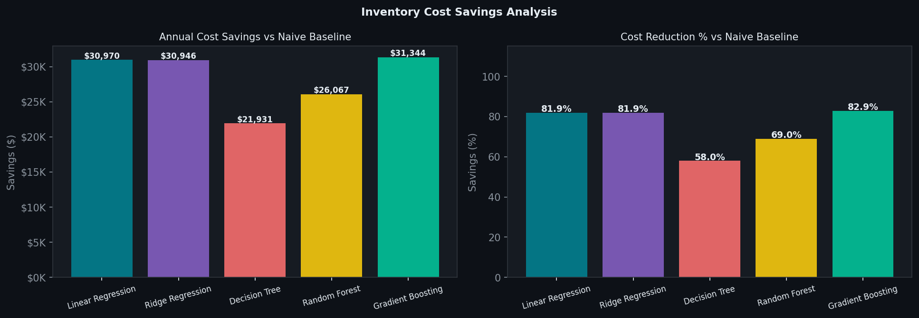
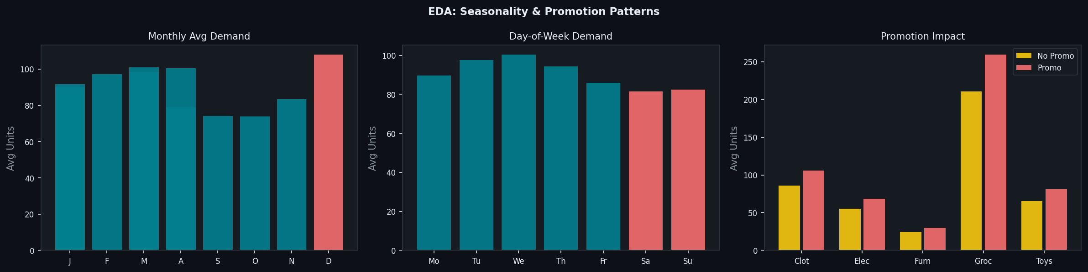
Cost Savings Analysis
Annual inventory cost reduction vs naive (always predict mean) baseline
Model | Savings/Yr | Reduction
Linear Regression | $30,970 | 81.9%
Ridge Regression | $30,946 | 81.9%
Decision Tree | $21,931 | 58.0%
Random Forest | $26,067 | 69.0%
Gradient Boosting | $31,344 | 82.9%
Naive Baseline | $0 saved | 0.0%
Naive baseline annual cost: $37,801
Demand Forecasting for Inventory Cost Reduction | ML Techniques — Phase 2
14 / 16

Slide 15
Insights & Observations
Phase 2 requirement: best model justification, overfitting analysis, feature engineering impact
BEST MODEL
Best Model Justification
Random Forest
1
Random Forest achieves R²=0.878 by averaging 100 bootstrap decision trees, reducing variance without increasing bias. Outperforms linear models by +27 R² points due to non-linear demand interactions.
0.8781
5.08 u
8.32%
6.40 u
Overfitting / Underfitting Analysis
R²
MAE
MAPE
RMSE
2
Linear models (R²≈0.60) underfit — demand is non-linear. Decision Tree shows slight high variance alone (depth=8). Random Forest's bagging corrects this. Gradient Boosting generalizes well despite boosting risk.
Cost Reduction Business Case
Feature Engineering Impact
4
ML forecasting reduces annual inventory cost from $37,801 (naive mean prediction) to as low as $6,457 — an 83% reduction. Justifies production deployment even with model serving infrastructure costs.
3
Lag features (demand_lag_1, roll_mean_7) contribute >40% of RF importance. Without temporal features, R² would be ~0.20 from raw columns alone. Engineering raised effective signal from 12 raw columns to 26 actionable features.
Temporal Split Non-Negotiable
5
Random shuffling in train-test split would cause future data leakage, inflating CV R² by 10–15%. KFold(shuffle=False) with TimeSeriesSplit ensures evaluations reflect real production forecasting scenarios.
Demand Forecasting for Inventory Cost Reduction | ML Techniques — Phase 2
15 / 16

Slide 16
Conclusions &
Phase 2 Summary
10,950
Phase 2 Summary
Dataset Rows
26
Random Forest is the best model — R²=0.878, MAE=5.08 units/day, MAPE=8.32%
Feature engineering (lag + rolling + calendar) raised R² from ~0.20 to 0.878
Non-linear ensemble models outperform linear by +27 R² points — demand is non-linear
Temporal split (shuffle=False) is mandatory — prevents future-data leakage
Gradient Boosting delivers highest business ROI: 82.9% cost savings ($31,344/year)
Features Built
5 Models
Evaluated
0.878
Best R²
8.32%
Phase 2 Deliverables Completed
Best MAPE
Feature engineering: missing values, encoding, scaling, 14 derived features
5 baseline models trained on identical 80/20 temporal split with cross-validation
Evaluation: MAE, MSE, RMSE, R², MAPE — clear comparison table presented
Visualizations: bar charts, scatter plots, timeline, error distribution, feature importance
83%
Max Cost Savings
$31,344
Best Annual Savings
Demand Forecasting for Inventory Cost Reduction | ML Techniques — Phase 2
16 / 16

